Slide 1

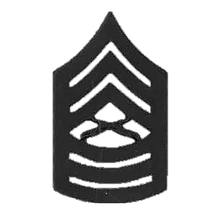


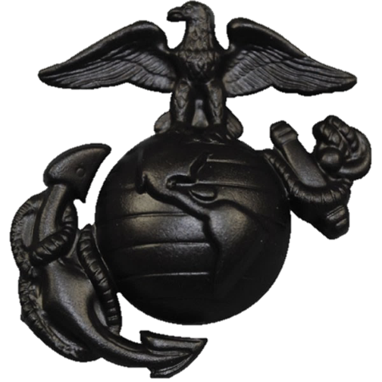




Master Sergeant
Brian P. LaPointe
Retirement Ceremony
December 1, 2017
2014
1994
2008
1994
2017
1995
2003
1997
2d Maintenance Battalion
Camp Lejeune, NC
1999

Slide 2
DEDICATION TO WIFE
My Foundation, My Keeper, My Wife.
She wore no uniform, no blues, or cammie green, but she lived the Corps, in the ranks rarely seen. She had no chevron upon her arm, salutes she did not give. But in the military world is the place in which she lived. She was not in the chain of command, orders she did not receive. But I am the one who did, this she did not forget. She was not the one, who fired the weapon, who put her life on the line, but her job was just as tough, she was the one left behind. Though she would not admit it, she is a patriot a brave and prideful soul. The call to serve our country was one all can understand. Behind the lines she saw the things needed to keep this country free. I made the sacrifice, but so did she. I love the one I married. Marine Corps was our life, but you stood among the silent ranks known as the military wife.
Sequence of Events
Invocation
National Anthem
Awards / Retirement
Retiring Officer Remarks
Master Sergeant LaPointe’s Remarks
“Anchors Aweigh”
“Marines’ Hymn”
Conclusion of Ceremony

Slide 3
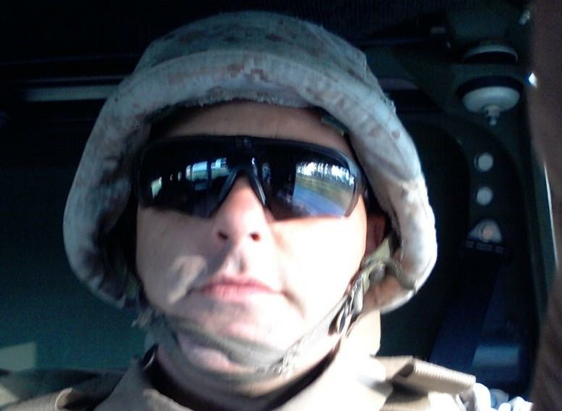
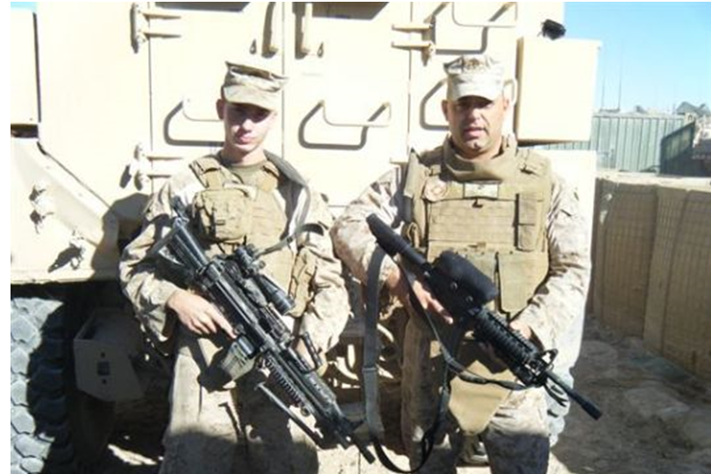
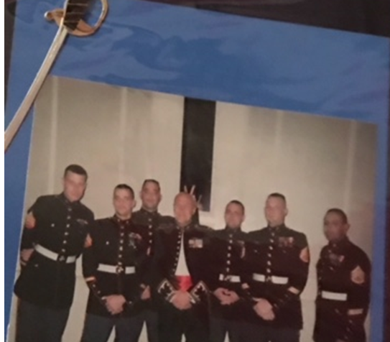
THE MARINES’ HYMN
From the Halls of Montezuma
To the shores of Tripoli;
We fight our country's battles
In the air, on land, and sea;
First to fight for right and freedom
And to keep our honor clean;
We are proud to claim the title
Of United States Marine.
Our flag’s unfurled to every breeze
From dawn to setting sun;
We have fought in every clime and place
Where we could take a gun;
In the snow of far-off Northern lands
And in sunny tropic scenes,
You will find us always on the job
The United States Marines.
Here's health to you and to our Corps
Which we are proud to serve;
In many a strife we've fought for life
And never lost our nerve.
If the Army and the Navy
Ever look on Heaven's scenes,
They will find the streets are guarded
By United States Marines.

Slide 4
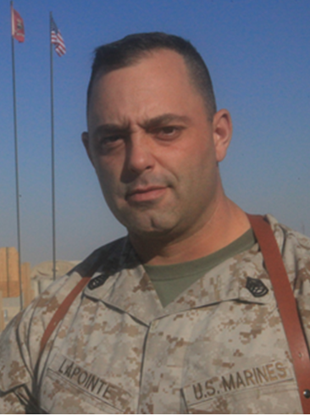
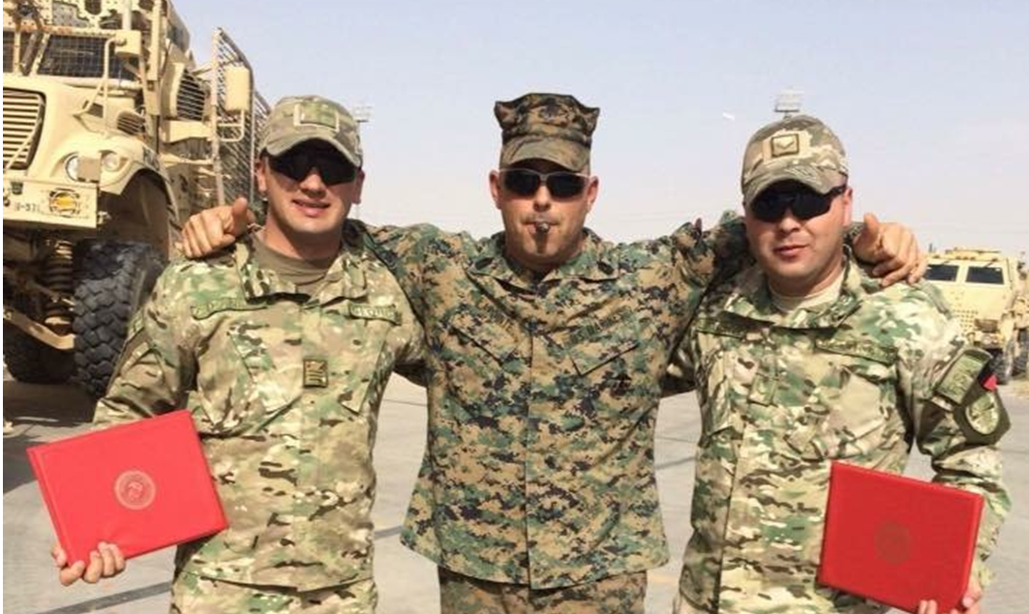
Master Sergeant B. P. LaPointe
Upon return from deployment Staff Sergeant LaPointe was promoted to Gunnery Sergeant, where he conducted duties as a Battalion FRO, and Company Gunny for H&S Company. Gunnery Sergeant LaPointe transferred to MT Company, MWSS 371, 3d MAW, Yuma, AZ in 2009. Where he conducted duties as Company First Sergeant, and performed duties as acting Sergeant Major for the MWSS-371 Squadron. During his tour with MWSS-371, Gunnery Sergeant LaPointe deployed as MT Company First Sergeant in support of Operation Enduring Freedom, he was awarded the Navy and Marine Corps Commendation Medal for conduct and performance while supporting an overseas mission.
Gunnery Sergeant LaPointe was then transferred to MTM Company, 2d Maintenance Battalion, Camp Lejeune, NC. He performed duties as 2d platoon Staff NCOIC, he was quickly transferred to MTM Company First Sergeant and also conducted duties as H&S Company First Sergeant.
In 2014, Gunnery Sergeant LaPointe was promoted to Master Sergeant and transferred to S-4 to assume all duties and maintain operations within the Battalion. Master Sergeant LaPointe returned to MTM Company, and was selected to participate in a Georgian Liaison Exercise at Bagram AFB, Afghanistan. Master Sergeant LaPointe licensed the Georgians on multiple military vehicles, the first Georgians to be licensed on the wrecker.
In 2016, Master Sergeant LaPointe returned home and was reassigned to MTM Company, 2d Maintenance Battalion as Platoon Commander, and conducted duties to improve vehicle maintenance and conducted all 3rd Echelon maintenance.
Master Sergeant LaPointe was born in
El Paso, Texas. He enlisted in the Marine
Corps in October 1994 and completed
recruit training at MCRD San Diego, CA
during December 1994. Following recruit training; Private First Class LaPointe attended Marine Combat training at Camp Pendleton, CA and Automotive Organizational Maintenance Course School at Camp Johnson, NC. Upon completion, he was assigned the MOS 3521, Automotive Mechanic.
Private First Class LaPointe reported to Maintenance Company, 3d FSSG, Camp Kinser Okinawa. While assigned to Camp Kinser, he conducted duties as an automotive mechanic. In July 1996, he reported to 8th Communication Battalion, 2d SRIG, II MEF, Camp Lejeune, NC. During his tour at 8th Communication, he pursued the duties of line mechanic. He was promoted to Corporal and held a leadership position as a Quality Control Inspector.
Corporal LaPointe was then transferred to MACS-1, MACG 38, 3d Marine Aircraft Wings, Yuma, AZ in March, 1999. While at MCAS-1, he was meritoriously promoted to Sergeant, conducted duties as Licensing NCO and Platoon Sergeant. During his tour Yuma, he was placed in charge of Heavy and Light sections. Sergeant LaPointe was temporarily assigned to Range Maintenance building targets for aircraft fly overs.
Sergeant LaPointe was then assigned a billet of Recruiting. He presented to RS Portsmouth, 1st MCD, RSS, Nashua, Nashua, NH. While on recruiting duty, Sergeant LaPointe was promoted to Staff Sergeant in 2003. Staff Sergeant LaPointe held the title of Recruiter of the year. Staff Sergeant LaPointe was transferred to the Officer Enlisted Program in Boston, MA.
Staff Sergeant LaPointe was then transferred to MTM Co, 2d Maintenance Battalion, Camp Lejeune, NC. He was in charge all 3rd Echelon/Wrecker section/licensing for all military vehicles. Staff Sergeant LaPointe deployed in support of Operation Iraqi Freedom in 2008 with CLB-8 as the Maintenance Chief. Staff Sergeant LaPointe received a Navy and Marine Corps Achievement Medal for performance during an overseas tour in 2008.

